Slide 1

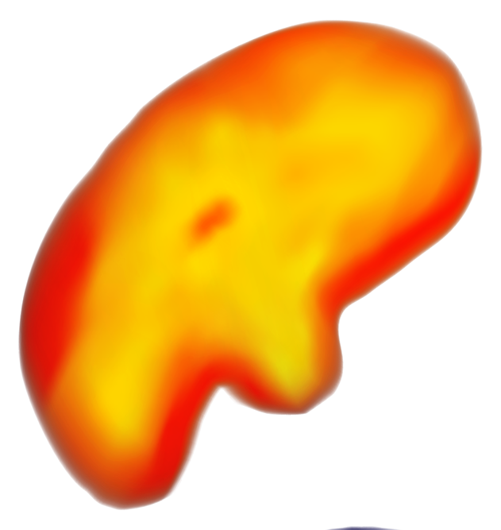
Advanced Drone Systems for Meteorological Exploration of Bioluminescent Cloud Decks on a Newly Discovered Gas Giant

Slide 2
TABLE OF CONTENTS
01
02
03
04
05
06
ABSTRACT
LOCATION ANALYSIS
DOMAIN DESIGN
COMPONENTS & MERGER
SAFETY SYSTEM & RISK ASSESSMENT
APPENDIX

Slide 3
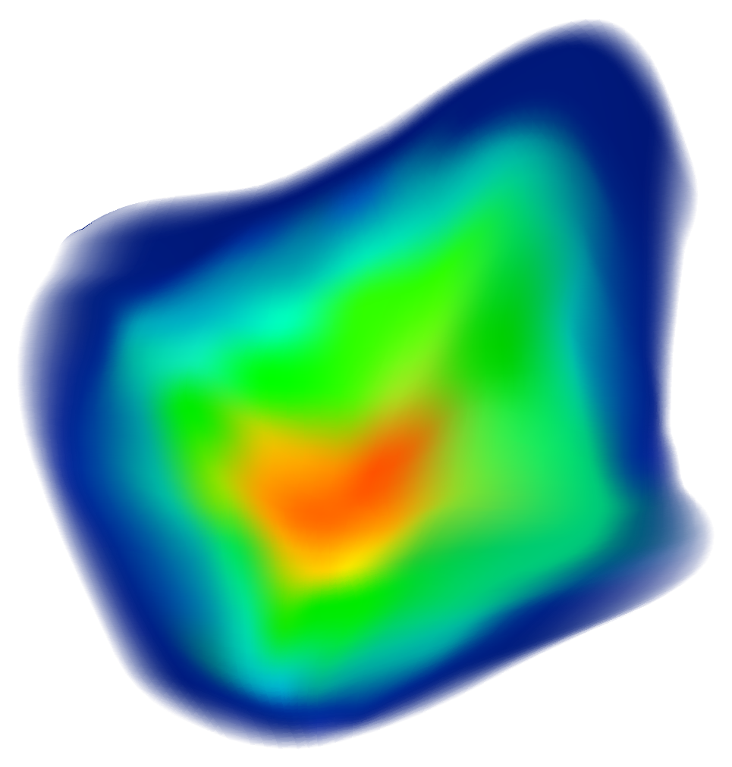
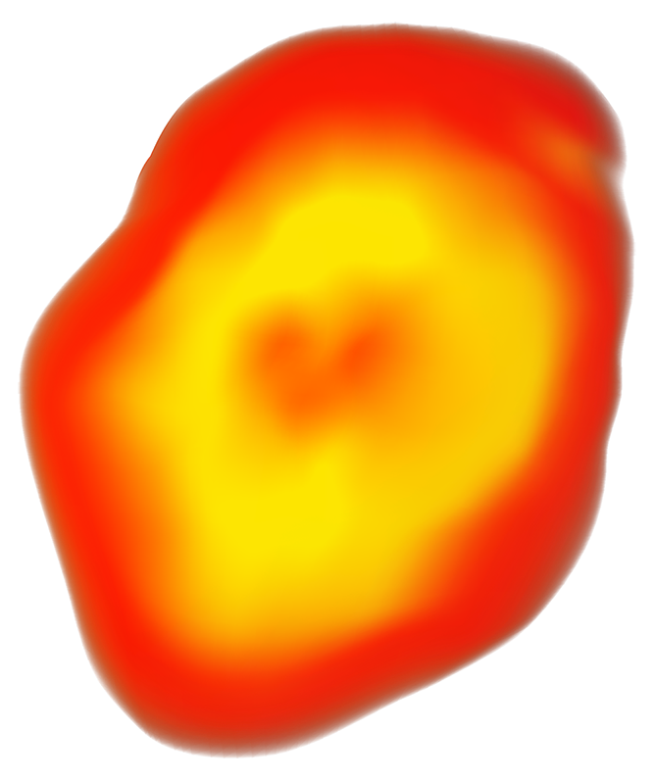
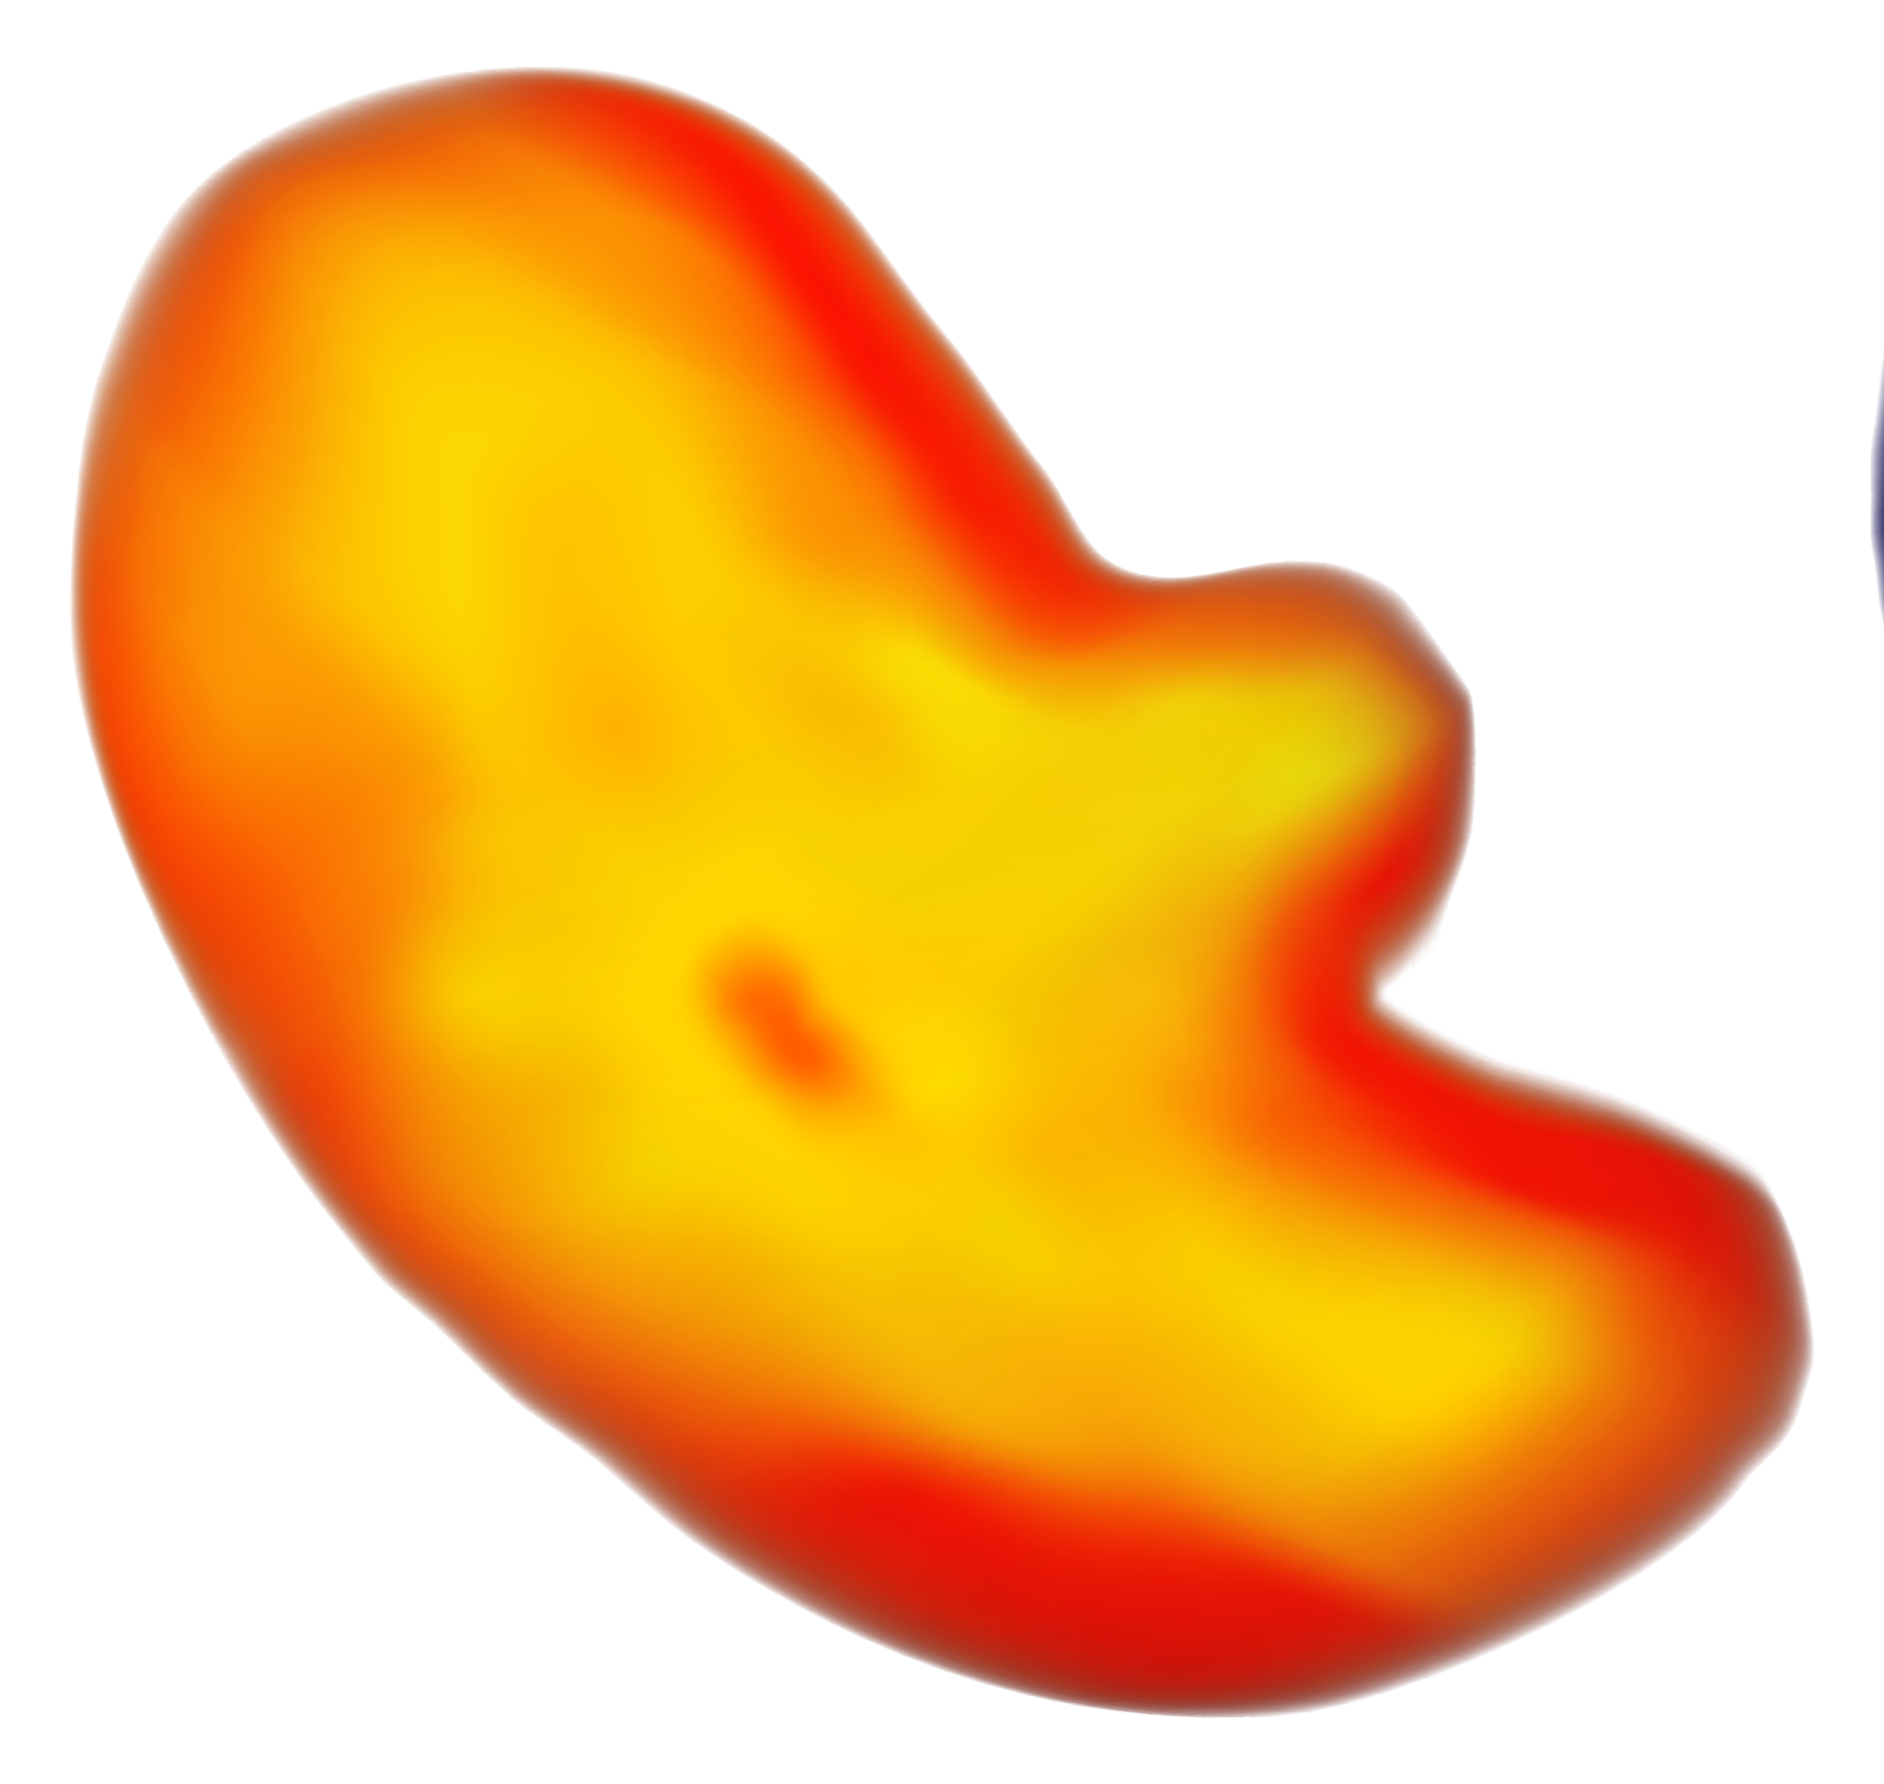
01
ABSTRACT

Slide 4
ABSTRACT
Designing an advanced drone system for meteorological research on a newly discovered gas giant.
Drone will autonomously navigate through bioluminescent cloud decks and various atmospheric layers.
Capable of capturing real-time data on cloud formation, temperature, humidity, atmospheric pressure, and wind speed.
Specialized sensors for mapping intricate glowing cloud patterns.
Spectrometers employed to analyze cloud coloration.
Equipped with an advanced propulsion system for optimal flight paths.
Autonomous navigation algorithms for obstacle avoidance and efficient data collection.
Data transmission to an orbiting satellite for real-time analysis.
Enhancing understanding of the planet's climate and supporting future exploration endeavors.

Slide 5
02
LOCATION ANALYSIS

Slide 6
LOCATION ANALYSIS
In the context of designing an advanced drone system for meteorological research on a newly discovered gas giant, a thorough location analysis is essential to understand the unique surroundings pertinent to the problem statement.
Geographical Location:
The gas giant, being a celestial body, presents a vastly different geographical landscape compared to Earth. Its massive size, intense gravitational forces, and lack of a solid surface pose significant challenges for drone navigation and data collection. Understanding the planet's gravitational pull and atmospheric density is crucial for designing a drone propulsion system capable of navigating through the various atmospheric layers.

Slide 7
LOCATION ANALYSIS
Environmental Conditions:
The planet's atmosphere is adorned with layers of bioluminescent cloud decks, each with its own unique composition and coloration. The uppermost layers consist of delicate, thin clouds, while deeper layers are thicker and more turbulent. These atmospheric conditions require specialized sensors capable of measuring cloud formation, temperature, humidity, atmospheric pressure, wind speed, and precipitation. Furthermore, the presence of bioluminescent clouds necessitates the integration of spectrometers to analyze cloud coloration and mapping sensors to study intricate glowing cloud patterns.

Slide 8
LOCATION ANALYSIS
Socio-Economic Context:
While the drone system is primarily designed for scientific research, considering the socio-economic implications is also important. The data collected by the drone could potentially lead to the discovery of valuable resources trapped within the clouds, which could have significant economic value. Additionally, the successful implementation of this innovative drone system could pave the way for future exploration endeavors, fostering international collaboration and advancing space exploration technologies.

Slide 9
02
Domain Design 1: Drone Propulsion and Navigation System

Slide 10
Domain Design 1: Drone Propulsion and Navigation System
Operational Framework:
The first domain focuses on the drone's propulsion and navigation system, which is vital for maneuvering through the various atmospheric layers of the newly discovered gas giant. The operational framework encompasses the design, integration, and testing of advanced propulsion mechanisms and autonomous navigation algorithms.

Slide 11
Domain Design 1
Functionalities:
Advanced Propulsion System: Develop a propulsion system capable of adapting to the planet's unique gravitational forces and atmospheric density variations. This includes designing thrusters, propellers, or other propulsion methods that can efficiently navigate through different atmospheric layers.
Autonomous Navigation Algorithms: Implement cutting-edge navigation algorithms that enable the drone to autonomously adjust its flight path, avoid obstacles, and optimize data collection routes. These algorithms should be capable of real-time decision-making based on sensor data and environmental conditions.

Slide 12
Domain Design 1
Applications:
Atmospheric Data Collection: Utilize the propulsion and navigation system to facilitate the drone's movement between bioluminescent cloud layers, allowing for the collection of real-time meteorological data.
Obstacle Avoidance: Enable the drone to detect and avoid obstacles such as turbulent cloud formations or atmospheric disturbances, ensuring safe and efficient navigation.

Slide 13
Domain Design 1
Designed Solutions:
Adaptive Propulsion Mechanism: Develop an adaptive propulsion mechanism that can modulate thrust and directionality based on real-time atmospheric data and navigation requirements.
Real-Time Navigation System: Implement a real-time navigation system that integrates sensor inputs, propulsion controls, and obstacle detection algorithms to autonomously navigate the drone through the planet's atmosphere.

Slide 14
Adaptive Propulsion Mechanism
Core Components:
1. Multi-directional Thrusters:
- Forward, upward, downward, lateral, and rotational thrust capabilities.
2. Variable Thrust Control System:
- Uses Pulse-Width Modulation (PWM) and Propeller Pitch Adjustment.
3. Atmospheric Sensor Suite:
- Pressure sensors, LiDAR/Ultrasound for obstacle detection, and Inertial Measurement Unit (IMU) for orientation and stability.
4. Flight Control System with AI Integration:
- Real-time data processing and machine learning for optimal thruster control.

Slide 15
Adaptive Propulsion Mechanism
Adaptive Operation:
Flight control system analyzes real-time atmospheric data and navigation goals.
AI calculates optimal thrust allocation for each thruster.
Variable thrust control adjusts power/pitch of thrusters for:
Flight direction: Course changes and obstacle avoidance.
Altitude control: Climbing or descending safely.
Stability maintenance: Ensuring orientation and stability.

Slide 16
Adaptive Propulsion Mechanism
Benefits:
Enhanced Maneuverability: Precise navigation in complex environments.
Safe Flight: Avoids rapid pressure changes.
Efficient Navigation: Optimizes flight paths and minimizes energy consumption.
Adaptability: Adjusts to unforeseen atmospheric conditions or obstacles.
Challenges:
Computational Complexity: Balancing computational power and efficiency.
Sensor Accuracy: Reliability of atmospheric sensors is crucial.
Model Training and Fine-tuning: Training AI with sufficient and accurate data on gas giant atmospheres.

Slide 17
Adaptive Propulsion Mechanism
Approach to the Challenges:Computational Complexity:
Solution: Implement a master-slave mechanism using Jetson Xavier and Jetson TX2 for optimized task distribution and efficiency.
Sensor Accuracy:
Solution: Utilize reliable LIDAR and IMU sensors for precise obstacle detection and drone positioning.
Model Training and Fine-tuning:
Solution: Employ DNN in RL and simulate various scenarios to enhance learning and adaptability.

Slide 18
Real-Time Navigation System
Data Collection:
Simulating the Gas Giant Environment: Understanding cloud formations, pressure variations, and turbulence patterns.
LiDAR Data Processing: Detecting obstacles and analyzing cloud formations.
Pressure Sensor Data Processing: Calculating pressure gradients and defining safe thresholds.
Camera Data Processing: Recognizing objects and landmarks for navigation.
Data Logging: Continuous recording of sensor data streams for analysis and training

Slide 19
Real-Time Navigation System
Data Preprocessing:
Data Cleaning: Handling outliers and missing values.
Data Normalization: Transforming data into a common range.
Feature Engineering: Creating new features for better model performance.
Model Selection:
Adaptability: Utilizing reinforcement learning and deep neural networks.
Generalization: Ensuring models can handle diverse scenarios.
Handling Complexity: Using deep reinforcement learning techniques.
Efficient Learning: Implementing algorithms with efficient learning mechanisms.

Slide 20
Real-Time Navigation System
Training Setup:
Dataset Splitting: Dividing data into training, validation, and testing sets.
Training Pipeline: Setting up a pipeline for data ingestion and model training.
Hyperparameter Tuning: Experimenting with different configurations.
Evaluation Metrics: Defining metrics for assessing model performance.
Evaluation and Monitoring:
Adaptive Training: Adjusting training based on real-time performance.
Evaluation Metrics: Assessing collision rate, navigation success, and mission completion time.

Slide 21
Real-Time Navigation System
Model Testing:
Validation Dataset: Evaluating model performance on an independent dataset.
Simulation Testing: Testing in simulated environments.
Continuous Validation: Ensuring performance in real-world operation.
Deployment and Integration:
Onboard Integration: Integrating the model into the drone's software.
Real-Time Decision-Making: Implementing mechanisms for dynamic trajectory adjustment.
Feedback Loop: Establishing a loop for continuous improvement.

Slide 22
Real-Time Navigation System
Continuous Monitoring and Improvement:
Operational Feedback: Collecting feedback from operational missions.
Data Collection: Collecting telemetry data and mission logs.
Iterative Improvement: Retraining the model with updated datasets.
Robustness and Safety Considerations:
Design for Sensor Failures: Implementing sensor fusion and fault detection.
Implementation of Safety Measures: Defining recovery behaviors and emergency shutdowns.
Real-Time Decision-Making and Adaptation: Dynamic risk management and adaptive control mechanisms.

Slide 23
Domain 2: Meteorological Data Collection and Analysis System
Core Components:
Data Collection:
Gas Giant Simulation
LiDAR Data Processing
Pressure Sensor Analysis
Camera Data Recognition
Continuous Data Logging
Data Preprocessing:
Data Cleaning
Data Normalization
Feature Engineering

Slide 24
Domain 2:
Model Selection:
Reinforcement Learning for Dynamic Adaptation
Deep Neural Networks for Complex Pattern Recognition
Efficient Algorithms for Real-time Analysis
Training Setup:
Dataset Splitting for Model Training
Training Pipeline Configuration
Hyperparameter Tuning for Model Optimization

Slide 25
Domain 2:
Evaluation and Monitoring:
Adaptive Training Based on Real-time Data
Evaluation Metrics for Data Accuracy
Collision Rate Monitoring
Model Testing:
Validation Dataset for Model Verification
Simulation Testing under Various Atmospheric Conditions
Continuous Validation in Real-world Operations
Deployment and Integration:
Onboard Software Integration for Real-time Analysis
Dynamic Decision Mechanisms for Adaptive Data Collection
Feedback Loop for Continuous Model Improvement

Slide 26
COMPONENTS
1.⁠ ⁠Global Navigation Satellite System (GNSS) Receiver
2.⁠ ⁠Inertial Measurement Unit (IMU)
3.⁠ ⁠Laser Range Finder (LRF) or Time-of-Flight (ToF) Sensors
4.Cloud Formation: High-Resolution Scientific Camera with Bioluminescent Filters, High-Precision LiDAR (Teledyne DALSA Cameras)
5.Temperature: Platinum Resistance Thermometer (PRT)

Slide 27
COMPONENTS
6.⁠Humidity : Capacitive Humidity Sensor
7.⁠Anemometers to Measure Wind Speed and Direction: Ultrasonic Anemometer
8.Atmospheric Pressure: Silicon Piezoresistive Pressure Sensor
9.⁠Precipitation (Optional): Optical Disdrometer
10.Jetson TX2 (Slave) and Jetson Xavier (Master)

Slide 28
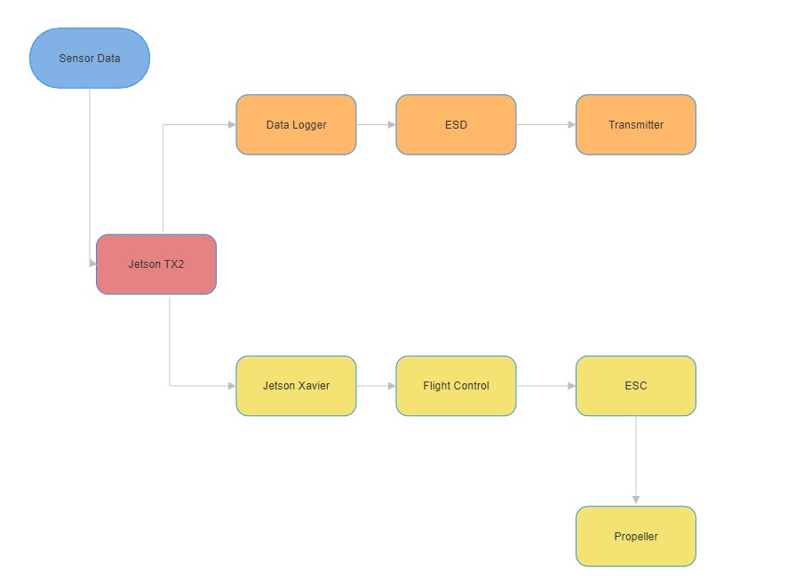
BLOCK DIAGRAM

Slide 29
SAFETY SYSTEM & RISK ASSESSMENT
Safety System Description:
Overview:
A robust safety system, comparable to waste disposal mechanisms, is detailed to ensure secure drone operation.
Measures:
Implementation of fail-safes, emergency shutdown protocols, and redundancy systems to mitigate risks and ensure safe drone navigation within the gas giant's atmosphere.

Slide 30
SAFETY SYSTEM & RISK ASSESSMENT
Risk Assessment:
Comprehensive Analysis:
Identification of potential hazards such as atmospheric turbulence, sensor malfunctions, and propulsion system failures.
Mitigation Strategies:
Development of contingency plans, regular system checks, and adaptive navigation algorithms to address and minimize identified risks during the mission.

Slide 31
APPENDIX
Method for Characterization of a Multirotor UAV Electric Propulsion System
Comprehensive Review on Electric Propulsion System of Unmanned Aerial Vehicles
Rusu, R. B., & Cousins, S. (2011). 3D is here: Point Cloud Library (PCL). In IEEE International Conference on Robotics and Automation (ICRA) (pp. 1-4). IEEE.
Vosselman, G., & Maas, H. G. (2010). Airborne and terrestrial laser scanning. CRC Press.

Slide 32
APPENDIX
6.⁠El-Sheimy, N., Habib, A., & Shahbazi, S. (2012). Mobile mapping systems: A review of hardware and software solutions. Sensors, 12(12), 17214-17244.
7.Stilla, U., & Zhu, X. X. (2015). Point cloud analysis in remote sensing: techniques and applications. ISPRS Journal of Photogrammetry and Remote Sensing, 105, 185-197.
8.Cheok, A. D., & Wee, H. S. (2010). Evaluation of point cloud data attributes and acquisition techniques for 3D modelling and analysis of built environment. In Proceedings of the 5th International Conference on 3D Geoinformation (pp. 20-25)

